Slide 1


Distributed Messaging with Apache Kafka
Mateusz Dymiński

Slide 2
whoami
Mateusz Dymiński
Software Developer(Architect) at Nokia
>10 years in industry
>6 years Java dev
>7 years Go dev
Still writing code : )
Tech confs speaker
LinkedIn, GitHub, FB, Twitter - see https://mateuszdyminski.com/

Slide 3


Materials: presentations, sources etc.
https://github.com/mateuszdyminski/dist-messaging-workshop

Slide 4

General rules of training

Slide 5
General rules
Training: 2 x 7h
Short breaks after sessions - 1h – 3-5mins
One long break for lunch – around 1pm ?
Ask questions anytime
Few exercises to keep you warm-up
No present list : )

Slide 6

Let's introduce ourselves

Slide 7
Exercise

Slide 8
Exercise
Think about problem which you would like to solve with Kafka
Write it down
Write down requirements/context
Functional requirements
Non-functional requirements
Constraints?
Time
Budget
Technology/Tools
Organisational/People
Send it to me - mail/zoom – dyminski@gmail.com

Slide 9
Exercise
During the workshop we’ll try to discuss your problems
And find solution ☺

Slide 10
Agenda
Overview of Distributed Messaging Systems
What's Apache Kafka
When it's worth to use Apache Kafka
Use Cases
Alternatives to Kafka
Kafka Design
Motivation
Persistence
Efficiency
The Producer
The Consumer
Message Delivery Semantics
Replication
Log compaction
Quotas

Slide 11
Agenda
Kafka API
Producer API
Consumer API
Kafka Connect
Kafka Streams
Kafka Admin API
Basic Kafka Operations
Adding and removing topics
Modifying topics
Graceful shutdown
Balancing leadership
Checking consumer position
Mirroring data between clusters
Expanding your cluster
Decommissioning brokers
Increasing replication factor

Slide 12
Agenda
Other
Datacenters
Important Server Configs
Important Client Configs
Production Server Configs
Monitoring
ZooKeeper
Extras – optional – depends on time
Kafka + Kubernetes
Kubernetes Operator
Kubernetes Storage
Strimzi
CDC with Debezium
Serializers
Schema Registry
Security

Slide 13

Overview of Distributed Messaging Systems

Slide 14
Overview of Distributed Messaging Systems
What’s Apache Kafka
When it's worth to use Apache Kafka
Use cases
Alternatives to Apache Kafka
Summary of part 1

Slide 15
What is Kafka?
Kafka is a messaging system that is designed to be fast, scalable, and durable.
It is an open-source stream processing platform.
Originated at LinkedIn and later became an open-source Apache project in 2011
Kafka is written in Scala and Java.
It aims at providing a high-throughput, low-latency platform for handling real-time data feeds.

Slide 16
What is Kafka?
Apache describes Kafka as a distributed streaming platform that lets us:
Publish and subscribe to streams of records.
Store streams of records in a fault-tolerant way.
Process streams of records as they occur.

Slide 17

When it's worth to use Apache Kafka

Slide 18
Apache Kafka - pros
Comparing to other message systems – almost always Kafka is a better choice – but it depends on use case – we will cover that later on
When we care about scalability
When we care about consistency
When we care about fault-tolerance / disasters
When we care about speed
When we have many consumers with vary performance
When we care about ordering
When we care about Exactly Once delivery

Slide 19
Apache Kafka - cons
To configure Kafka in fault-tolerant way – we need quite a lot of resources(cpu, mem, storage)
We need to have fast storage
We need to remember about Zookeeper – at least for a while
In most cases we need to deploy/operate Kafka by ourselves – but there are commercial platforms which offers Kafka in SaaS model

Slide 20

Use Cases

Slide 21
Use cases
Messaging / Asynchronous communication
Streaming
Real-Time processing
Metrics / Log aggregation
CQRS / Event Sourcing
Change Data Capture
Geo-replication

Slide 22
Messaging / Asynchronous communication
Services communicating by exchanging messages over messaging channels.
Very common in microservices world
Kafka main use case – send receive messages in publish-subscribe model
If we would like to send the message/event to other system/service we use producer
If we would like to be notify that message appears in topic – we use consumer

Slide 23
Messaging / Asynchronous communication
There are several different styles of asynchronous communication:
Request/response - a service sends a request message to a recipient and expects to receive a reply message promptly
Notifications - a sender sends a message a recipient but does not expect a reply. Nor is one sent.
Request/asynchronous response - a service sends a request message to a recipient and expects to receive a reply message eventually
Publish/subscribe - a service publishes a message to zero or more recipients
Publish/asynchronous response - a service publishes a request to one or recipients, some of whom send back a reply

Slide 24
Asynchronous communication - benefits
Loose runtime coupling since it decouples the message sender from the consumer
Improved availability since the message broker buffers messages until the consumer is able to process them
Supports a variety of communication patterns including request/reply, notifications, request/async response, publish/subscribe, publish/async response etc

Slide 25
Asynchronous communication - cons
Additional complexity of message broker, which must be highly available
Request/reply-style communication is more complex
Harder to test – i.e. think about isolation in E2E tests

Slide 26
Messaging / Asynchronous communication - examples
Communication in microservices
Offload the consumers in your systems
CQRS
Many more

Slide 27
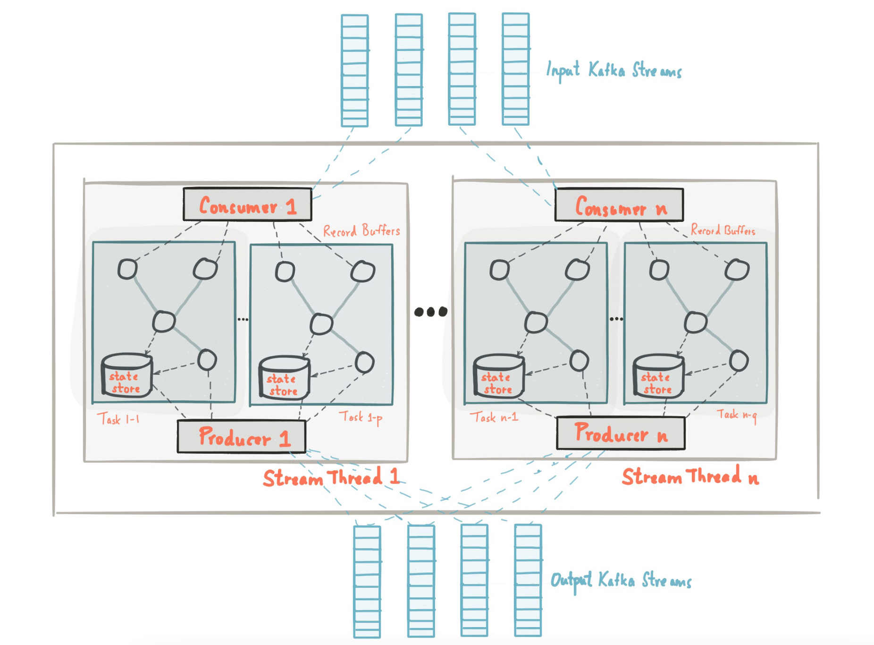
Streaming

Slide 28
Streaming
If we would like to switch from req/resp model to world of streams
Immediatelly propagate event as they occur in our system
Fully async communication
Build materialized views on top of topics

Slide 30
Streaming
Kafka has build-in API for that!
Processor, KStream, Ktables, GlobalKTable are your friends
You can build your application based on that API
These applications are run outside of the Broker
Dedicated DSL

Slide 31
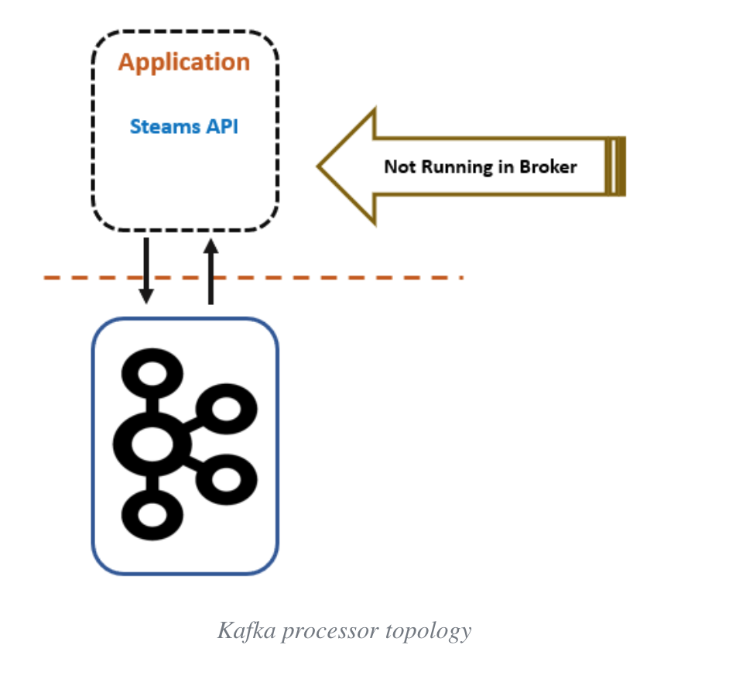
Source: https://dzone.com/articles/real-time-stream-processing-with-apache-kafkapart-1

Slide 32
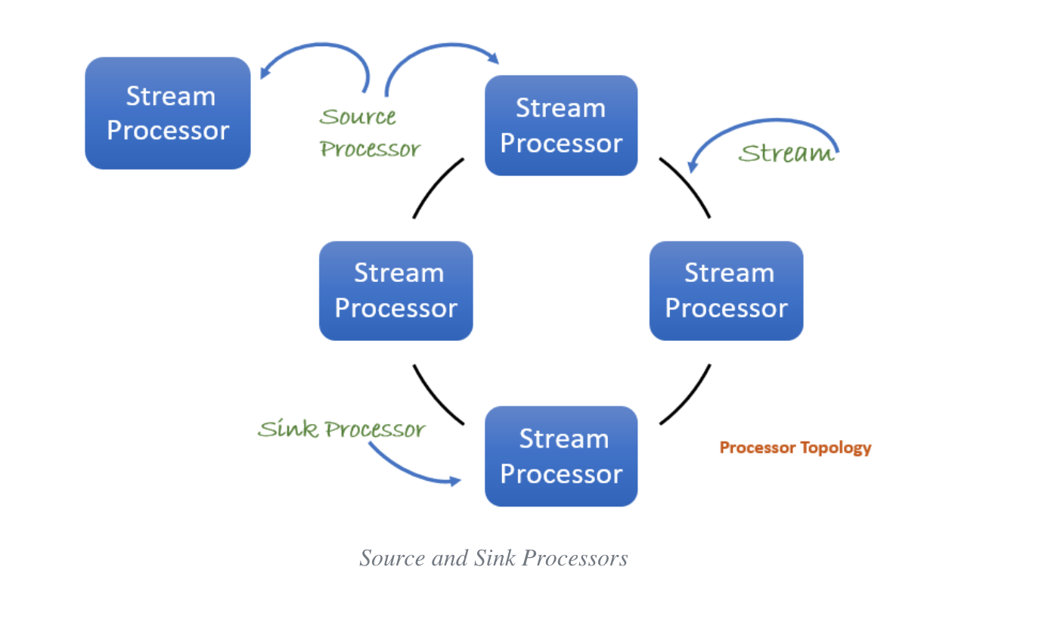
Source: https://dzone.com/articles/real-time-stream-processing-with-apache-kafkapart-1

Slide 33
Streaming - examples
Aggregations – numer of visits from particular country
Joins – visitors and their preferences
Filtering
Windowing – how many events per min/hour/day
KTables
Views

Slide 34
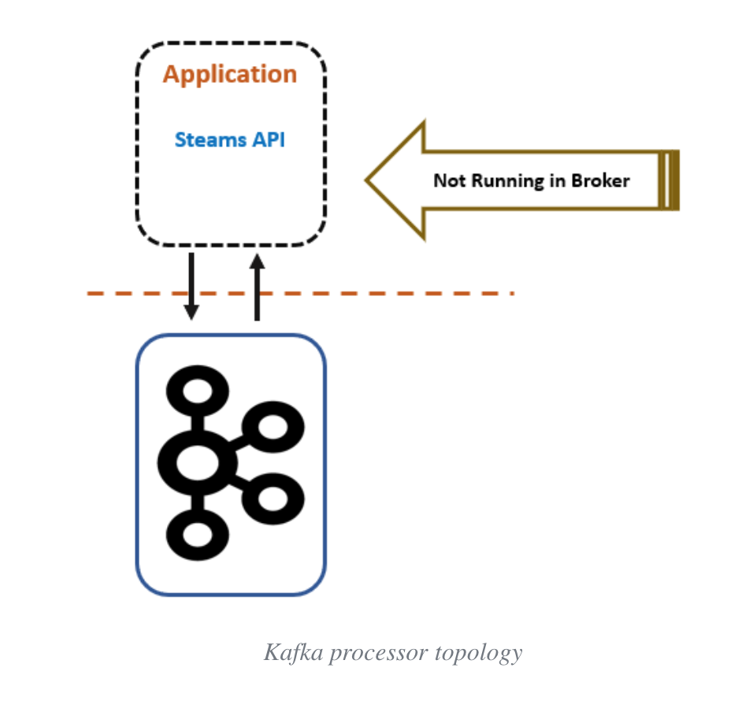
Real-Time processing

Slide 35
Metrics / Log aggregation
Ingest high load of data to your system
Real-time is not that important
Throughtput is most important here
It should survive extream numer of incomming messages
Processing might take some time, but message/event/logs/metric must be received
Examples: Datadog / Elastic / Librato / Splunk etc.

Slide 36

Event Sourcing + CQRS

Slide 37
Event Sourcing
Problem:
A service typically needs to update the database and send messages/events.
A service must atomically update the database and send messages in order to avoid data inconsistencies and bugs.

Slide 38
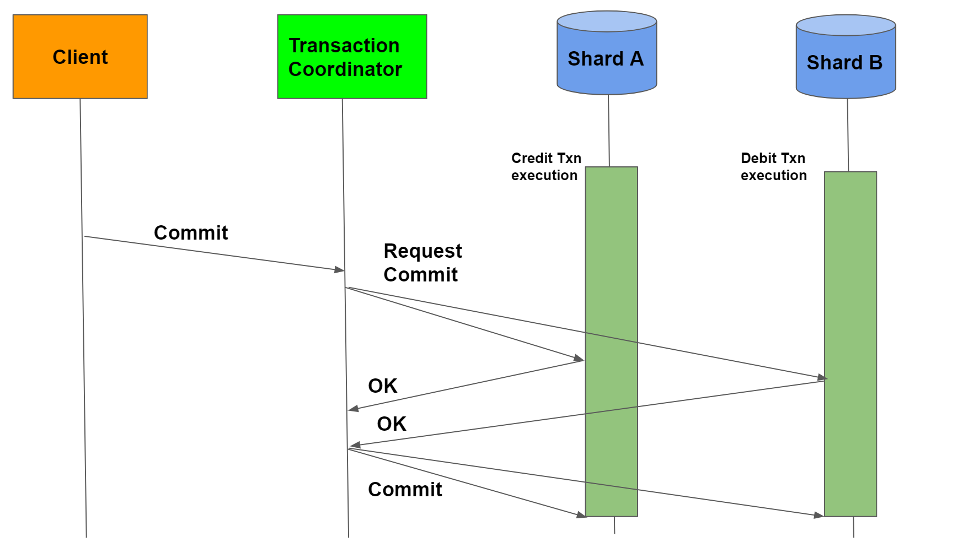
Event Sourcing
Solution:
2PC – Two Phase Commit

Slide 39
Event Sourcing
Problem:
Make update the database and publish messages/events to another system
It works in context of 2 DBs, but not when we have 1DB and 1 messaging system(of course if queue doesn’t supports 2PC)
If the database transaction commits messages must be sent. Conversely, if the database rolls back, the messages must not be sent

Slide 40
Event Sourcing
Solution to this problem is to use event sourcing.
Event sourcing persists the state of a business entity such an Order or a Customer as a sequence of state-changing events
Whenever the state of a business entity changes, a new event is appended to the list of events.
Since saving an event is a single operation, it is inherently atomic.
The application reconstructs an entity’s current state by replaying the events.

Slide 41
Event Sourcing
Applications persist events in an event store, which is a database of events.
The store has an API for adding and retrieving an entity’s events.
The event store also behaves like a message broker.
It provides an API that enables services to subscribe to events.
When a service saves an event in the event store, it is delivered to all interested subscribers.

Slide 42
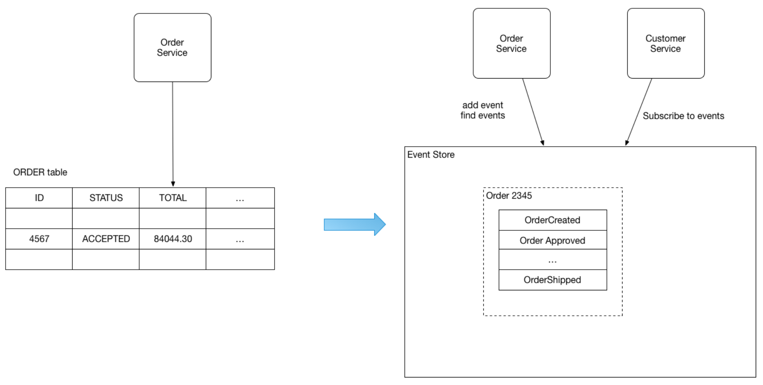
Event Sourcing

Slide 43
Event Sourcing – another problem
How to query Event store to get current state of Order?
Should we query for all of the events every time?

Slide 44
CQRS

Slide 45
CQRS
CQRS = Command Query Responsibility Segregation
Problem
How to implement a query that retrieves data from multiple services in a microservice architecture?

Slide 46
CQRS
Solution:
Define a view database, which is a read-only replica that is designed to support that query.
The application keeps the replica up to data by subscribing to Domain events published by the service that own the data.

Slide 47
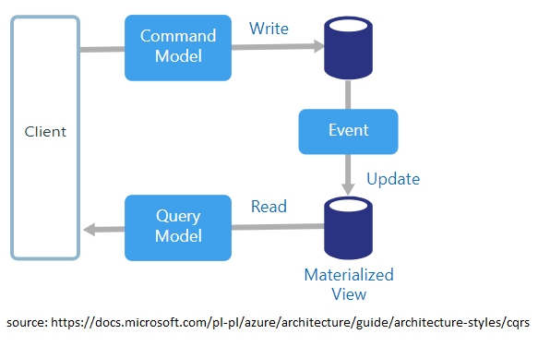
CQRS

Slide 48
CQRS
This pattern has the following benefits:
Supports multiple denormalized views that are scalable and performant
Improved separation of concerns = simpler command and query models
Necessary in an event sourced architecture

Slide 49
CQRS
This pattern has the following drawbacks:
Increased complexity
Potential code duplication
Replication lag/eventually consistent views

Slide 50
Event Sourcing – with Kafka
To implement CQRS with Kafka, you write directly to a topic,
This is faster than writing to a database, which has indexes that must be updated.
The events are then pushed from Kafka into a view on the read side, from where they can be queried.
Chronological reductions are performed before the data is inserted into the view.

Slide 51

Change Data Capture

Slide 52
Change Data Capture
change data capture (CDC) is a set of software design patterns used to determine and track the data that has changed so that action can be taken using the changed data.

Slide 53
Log-based Change Data Capture
Based on WAL, Redo logs, Binlog
All data changes are captured
No polling or overhead
Transparent – no need to touch any of old/legacy applications
Event with changes is sent to subscribers
Reactive approach

Slide 54
SQL
CREATE TABLE users (
id SERIAL PRIMARY KEY,
firstname TEXT NOT NULL,
lastname TEXT NOT NULL,
created_at TIMESTAMP DEFAULT NOW()
);

Slide 55
Following INSERT
INSERT INTO users(firstname, lastname) VALUES('Johny', 'Rambo');
Produces following EVENT
{
"change": [
{
"kind": "insert",
"schema": "public",
"table": ”users",
"columnnames": [”id”, ”firstname", ”lastname", "created_at"],
"columntypes": [
"integer",
”text",
”text",
"timestamp without time zone"
],
"columnvalues": [1, ”Johny", ”Rambo", "2020-09-15 11:58:28.988414"]
}
]
}

Slide 56
Following UPDATE
UPDATE users SET lastname = 'Kowalski' WHERE id = 1;
Produces following EVENT
{
"change": [
{
"kind": "update",
"schema": "public",
"table": "users",
"columnnames": ["id", "firstname", "lastname", "created_at"],
"columntypes": ["integer", "text", "text", "timestamp without time zone"],
"columnvalues": [1, "Johny", "Kowalski", "2020-09-15 11:58:28.988414"],
"oldkeys": {
"keynames": ["id"],
"keytypes": ["integer"],
"keyvalues": [1]
}
}
]
}

Slide 57
Following DELETE
DELETE FROM users WHERE id = '1';
Produces following EVENT
{
"change": [
{
"kind": "delete",
"schema": "public",
"table": "users",
"oldkeys": {
"keynames": ["id"],
"keytypes": ["integer"],
"keyvalues": [1]
}
}
]
}

Slide 58

Streaming

Slide 59

Streaming
Legacy App
DB

Slide 60

Streaming
Legacy App
DB
ElasticSearch
CDC

Slide 61
CDC - Microservices Communication

Slide 62
Data Synchronization
Analytics DB
Insert
Create New Account
Users Service
Insert
DB
Insert
ElasticSearch
BAD DESIGN

Slide 63
Data Synchronization
Create New Account
Users Service
Insert
DB
Propagate data between different
services without coupling
Inserted User
Inserted User
CDC
Inserted User
Inserted User
Audit DB
Kafka Connect Sink Connector
Analytics Service
Analytics DB

Slide 64

Replication

Slide 65
Replication and Geo-replication – why?
Geo-replication
Disaster recovery
Feeding edge clusters into a central, aggregate cluster
Physical isolation of clusters (such as production vs. testing)
Cloud migration or hybrid cloud deployments
Legal and compliance requirements

Slide 66
Mirror Maker
Replication and geo-replication is done with MirrorMaker(2)
MirrorMaker 2 (MM2) is designed to make it easier to mirror or replicate topics from one Kafka cluster to another.
It uses the Kafka Connect framework to simplify configuration and scaling.
Dynamically detects changes to topics and ensures source and target topic properties are synchronized, including offsets and partitions

Slide 67
Replication types
Active/Active high availability deployments: A->B, B->A
Active/Passive or Active/Standby high availability deployments: A->B
Aggregation (e.g., from many clusters to one): A->K, B->K, C->K
Fan-out (e.g., from one to many clusters): K->A, K->B, K->C
Forwarding: A->B, B->C, C->D

Slide 68

Exercise 1

Slide 69

Alternatives to Apache Kafka

Slide 70
Alternatives to Apache Kafka - As Queue
RabbitMQ
AtiveMQ
NATS
Redis
Amazon SQS / Azure Service Bus / GCE Pub/Sub

Slide 71
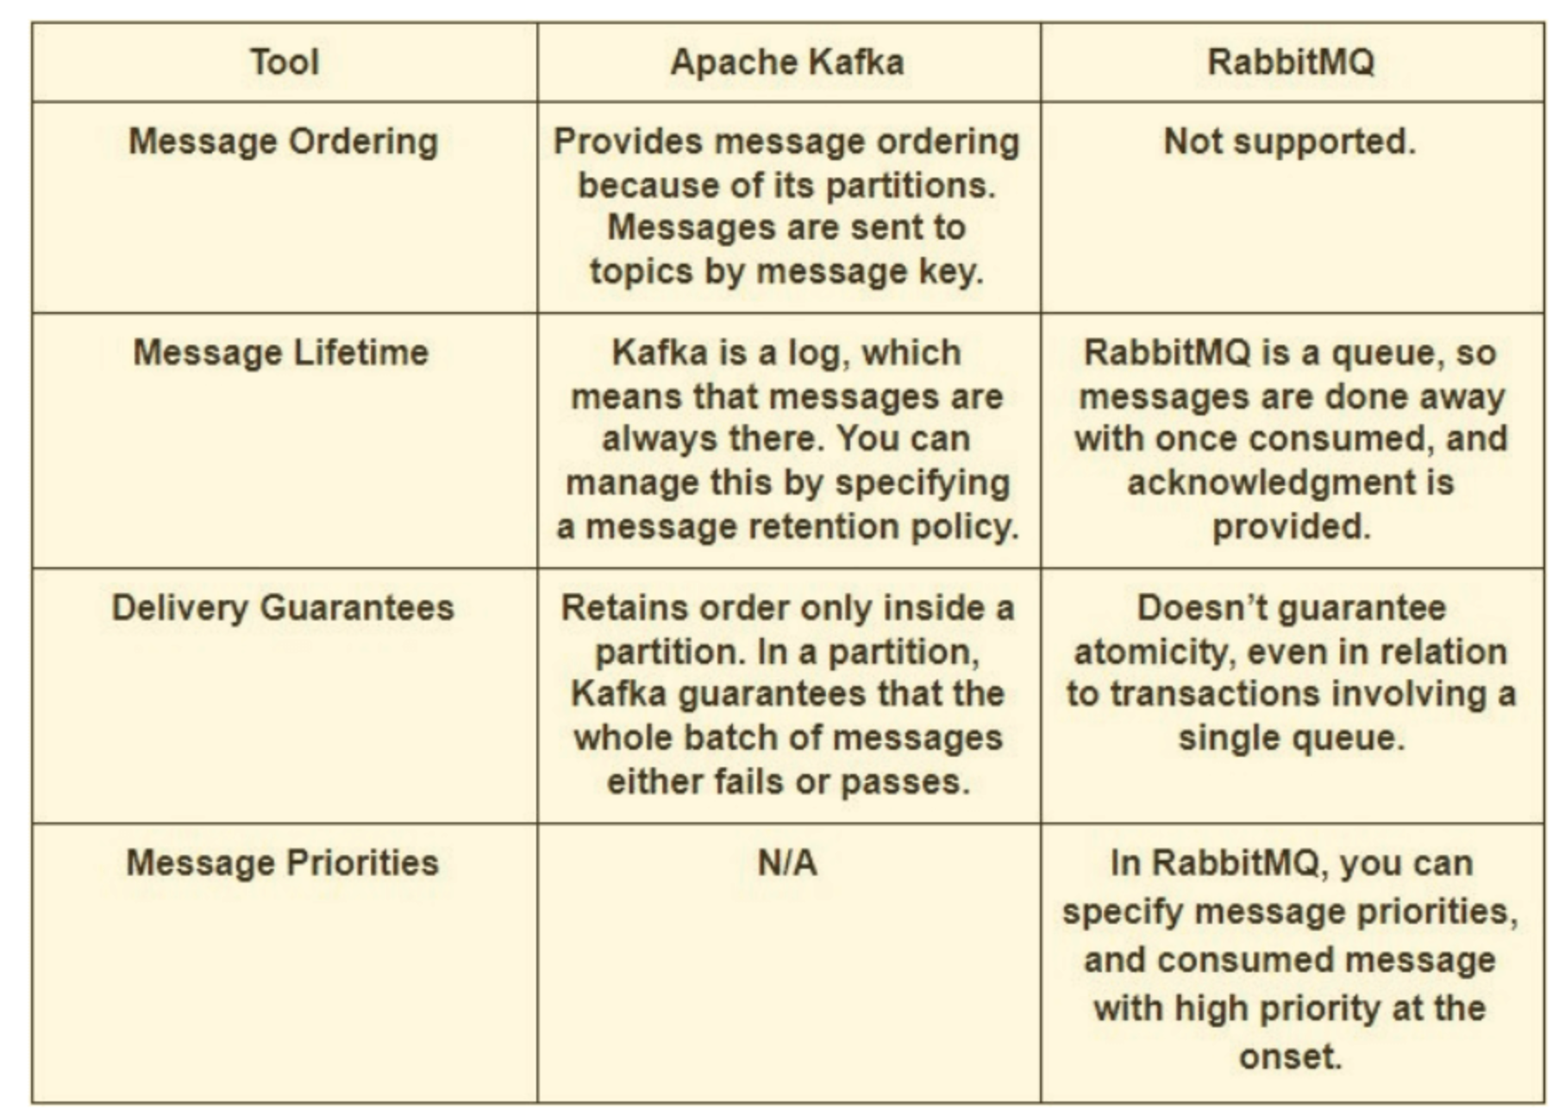
RabbitMQ vs Kafka
Source: https://www.upsolver.com/blog/kafka-versus-rabbitmq-architecture-performance-use-case

Slide 72
RabbitMQ
Scenarios that RabbitMQ can be used for:
Applications that need to support legacy protocols, such as STOMP, MQTT, AMQP, 0-9-1.
Granular control over consistency/set of guarantees on a per-message basis
Complex routing to consumers – like priorities
Applications that need a variety of publish/subscribe, point-to-point request/reply messaging capabilities.

Slide 73
AtiveMQ
JMS API implements a fundamental semantic difference between a queue (peer-to-peer) and topic(publish-subscribe) destinations.
ActiveMQ provides optional durability - Storage is non required
All messages are coming in one flow
Messages are round-robin distributed between a unlimited number of consumers
Storage is non required
Besides native OpenWire it also supports AMQP, STOMP, MQTT, XMPP.

Slide 74
NATS
NATS is lightweight pub-sub messaging platform
NATS implements what is commonly referred to as at-most-once delivery
if a subscriber drops out, it will not receive messages
NATS platform is a simple pub-sub transport system that offers only TCP-grade reliability
Usually it’s faster
NATS cluster is much simpler to operate

Slide 75
Redis pub-sub
Redis supports push-based delivery of messages
every message pushed to Redis will be delivered automatically to all the subscribers
Redis does not store messages instead
Redis is used usually If you want a fire-and-forget kind of system

Slide 76
Amazon SQS / Azure Service Bus / GCE Pub/Sub
All of them in SaaS model
No hosting available outside of AWS/Google/Azure
Contains messages limits
Shines in ecosystem

Slide 77
Alternatives to Apache Kafka - As Messaging Platform
Apache Spark
Apache Storm
Apache Flume

Slide 78
Apache Spark
Usually it’s Kafka Streams vs Apache Spark Streaming
We cannot use Apache Spark as messaging system

Slide 79
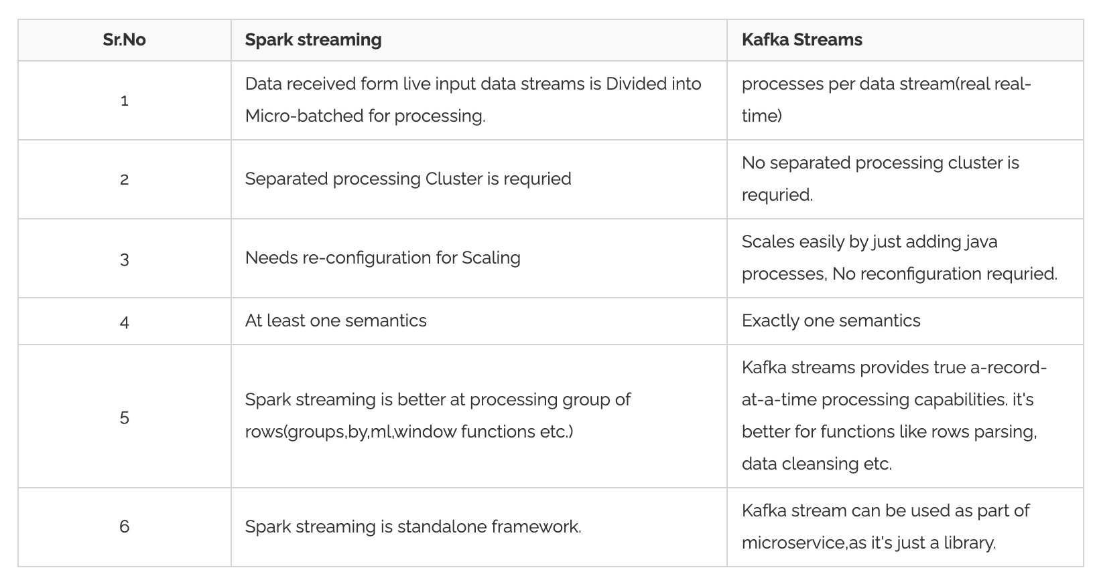
Source: https://www.knowledgehut.com/blog/big-data/kafka-vs-spark

Slide 80
Apache Flume
Again it’s Kafka Streams vs Apache Flume
We cannot use Apache Flume as messaging system
It is basically working as a push model
It is specially designed for Hadoop.
Common use-case: collect log data from distributed web servers.

Slide 81
Apache Storm
Storm works on a Real-time messaging
Kafka can store its data on local filesystem while Apache Storm is just a data processing framework.
Kafka is a real-time streaming unit while Storm works on the stream pulled from Kafka.

Slide 82
Kafka Design

Slide 83
Design
Motivation
Main concepts
Persistence
Performance
The Producer
The Consumer
Message Delivery Semantics
Replication
Log compaction
Quotas

Slide 84
Motivation

Slide 85
Motivation
Kafka was developed around 2010 at LinkedIn by a team that included Jay Kreps, Jun Rao, and Neha Narkhede
Problem which solves was low-latency ingestion of large amounts of event data from the LinkedIn
The key was the "real-time" processing.
At the time, there weren't any solutions for this type of ingress for real-time applications.
Real-time systems such as the traditional messaging queues (think ActiveMQ, RabbitMQ, etc.) they are overkill for the use case LinkedIn had in mind

Slide 86
Motivation
LinkedIn) wants to build fancy machine-learning algorithms, but without the data, the algorithms are useless
Getting the data from source systems and reliably moving it around was very difficult
Back in 2011, Kafka was ingesting more than 1 billion events a day
Recently, LinkedIn has reported ingestion rates of 1 trillion messages a day

Slide 87
Main concepts

Slide 88
Records
Records = message = event
Each record consists of a key, a value, and a timestamp.
Categorized into Topics
Message = byte array
Serializer is not necessary

Slide 89
Topics
A topic is a category to which records are published.
Producers write data to topics and consumers read from them
Topics in Kafka are always multi-subscriber
Topics are partitioned
Topics are persistent – records are stored on the disk

Slide 90
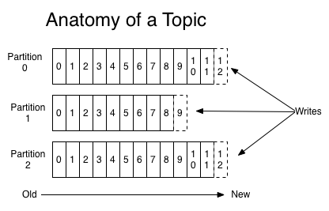
Source: https://kafka.apache.org/intro

Slide 91
Partitions
Each topic has one or more partitions
Order is preserved within single partition
Partitions are replicated across cluster
Records are added to the very end of each partitions

Slide 92
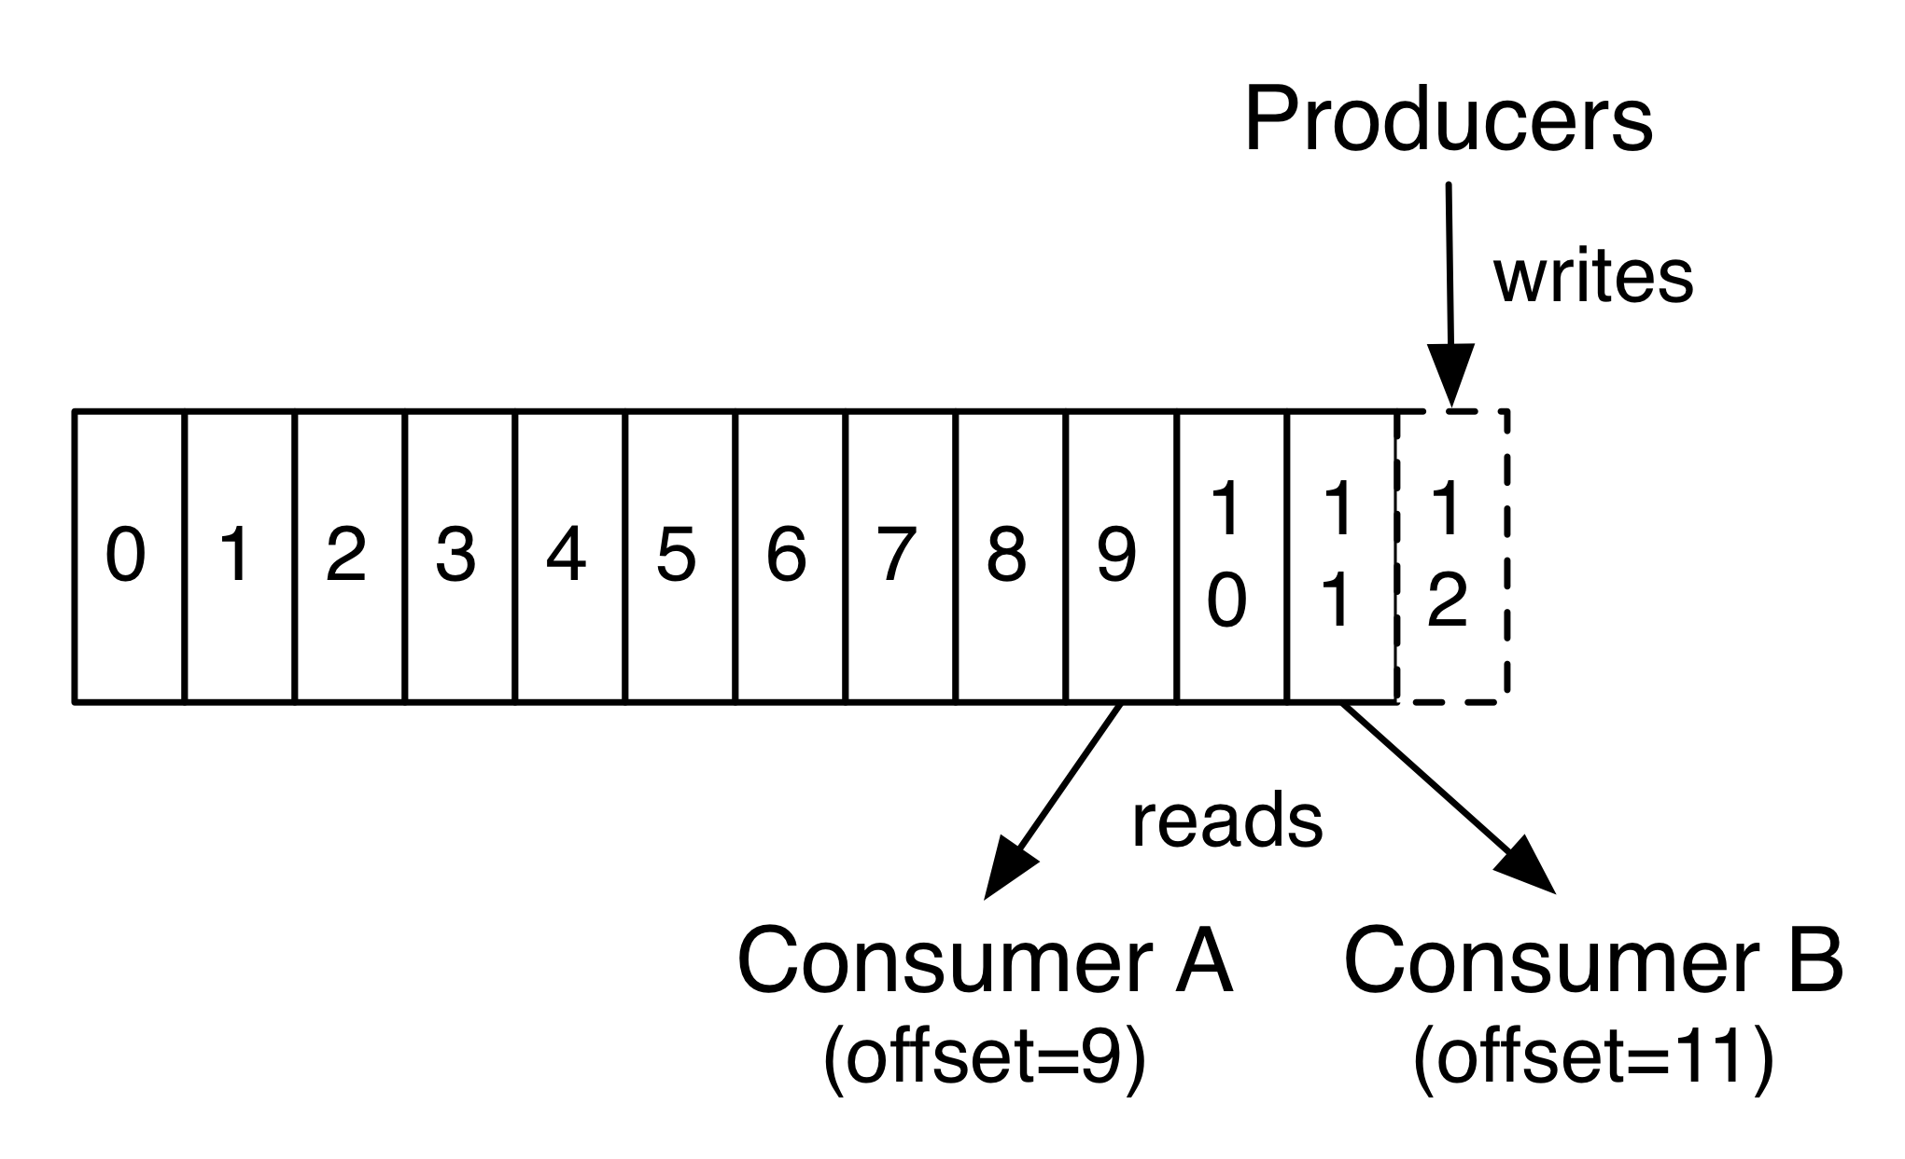
Partition Offset
Each partitioned message has a unique sequence ID called an offset.
Offset is unique per partition only
Source: https://kafka.apache.org/intro

Slide 93
Replicas
Replica is a backup of a partition
Replication factor tells the cluster how many of identical replicas should be created on the cluster
Replicas are never used to read or write data.
They are used to prevent data loss.
There can be one or many replicas of a partition
One leader and many followers
In-Sync Replica is a replica that has enough records to be considered in partition leader election

Slide 94
Brokers
Kafka Broker is a Kafka server that manages records
Receives messages
Assigns offsets
Commits messages to storage on disk
Each broker may have zero or more partitions per topic.

Slide 95
Cluster
When Kafka has more than one broker, it is called a Kafka cluster.
A Kafka cluster can be expanded without downtime.

Slide 96
Zookeeper
It backups the date critical metadata of Kafka Cluster
Responsible for ellection
Stores ACLs
Stores list of available Kafka brokers

Slide 97
Persistence

Slide 98
Persistence
Kafka relies heavily on the filesystem for storing and caching messages.
There is a general perception that "disks are slow”
But
Sequential disk access can in some cases be faster than random memory access!

Slide 99
Persistence
Kafka relies heavily on the filesystem for storing and caching messages.
There is a general perception that "disks are slow”
But
Sequential disk access can in some cases be faster than random memory access!

Slide 100
Persistence
Furthermore, Kafka is build on top of the JVM, and anyone who has spent any time with Java memory usage knows two things:
The memory overhead of objects is very high, often doubling the size of the data stored (or worse).
Java garbage collection becomes increasingly fiddly and slow as the in-heap data increases.

Slide 101
Persistence
Modern unix operating systems offer a highly optimized code path for transferring data out of pagecache to a socket;
in Linux this is done with the sendfile system call.
This combination of pagecache and sendfile means that on a Kafka cluster where the consumers are mostly caught up you will see no read activity on the disks whatsoever as they will be serving data entirely from cache.
For more background on the sendfile and zero-copy support in Java, see this article.

Slide 102
Topic partitions and log segments
The data in a topic partition is split into log segments.
For each log segment, there is a file on disk.
One of the segments is the active segment into which messages are currently written.
Once the size or time limit of the active segment is reached, the corresponding file is closed and a new one is opened.
By splitting the data of a topic partition into segments, Kafka can purge and compact messages from the non-active segments.

Slide 103
Topic partitions and log segments
When the data is written to a log segment, by default it is not flushed to disk immediately.
Kafka relies on the underlying operating system to lazily flush the data to disk, which improves performance.
Although this might appear to increase the risk of data loss, in most cases, each topic partition will be configured to have more than 1 replica.
So, the data will exist on more than one broker.

Slide 104
Topic partitions and log segments
Kafka has server and per-topic configuration parameters that allow the frequency of flushing of segment data to disk
In general, you should not override the default of allowing the operating system to decide when to flush the segment data to disk
You should rely on replication for the durability of your data.
Kafka deeply leverages the Linux page cache and zero-copy mechanism to avoid copying data into user space.

Slide 105
Exercise 2

Slide 106
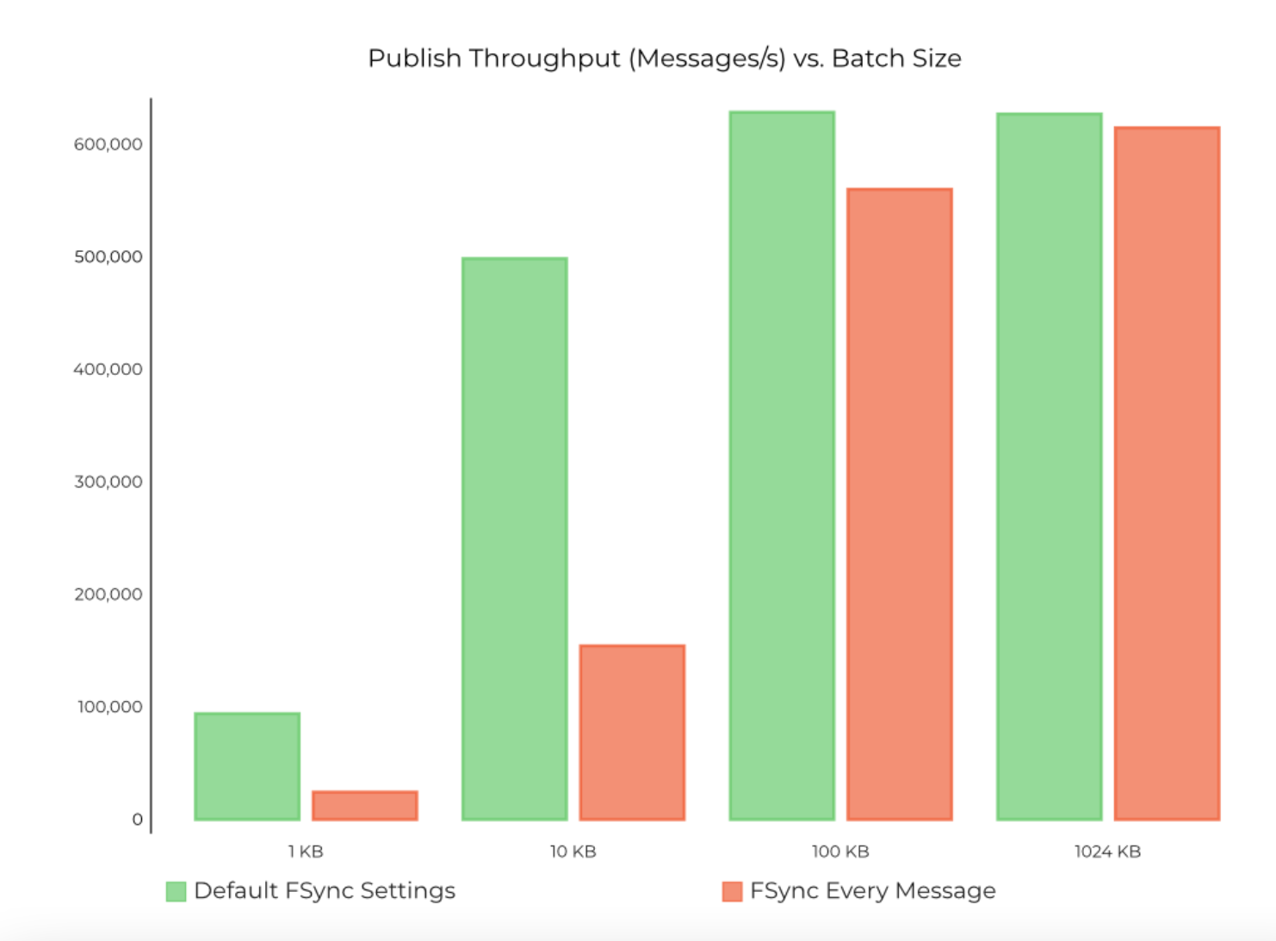
Persistence
Source: https://www.confluent.io/blog/kafka-fastest-messaging-system/

Slide 107
Performance

Slide 108
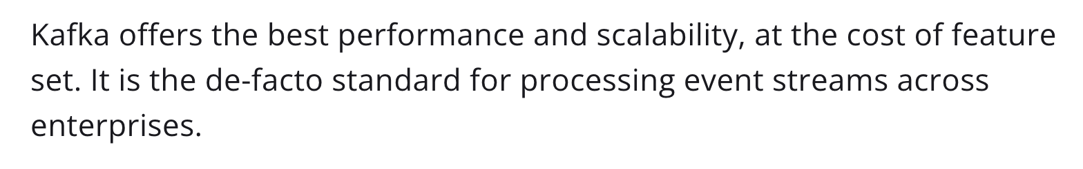
Performance
Great articles which covers the topic:
https://softwaremill.com/mqperf/
https://www.confluent.io/blog/kafka-fastest-messaging-system/
To sum things up:

Slide 109
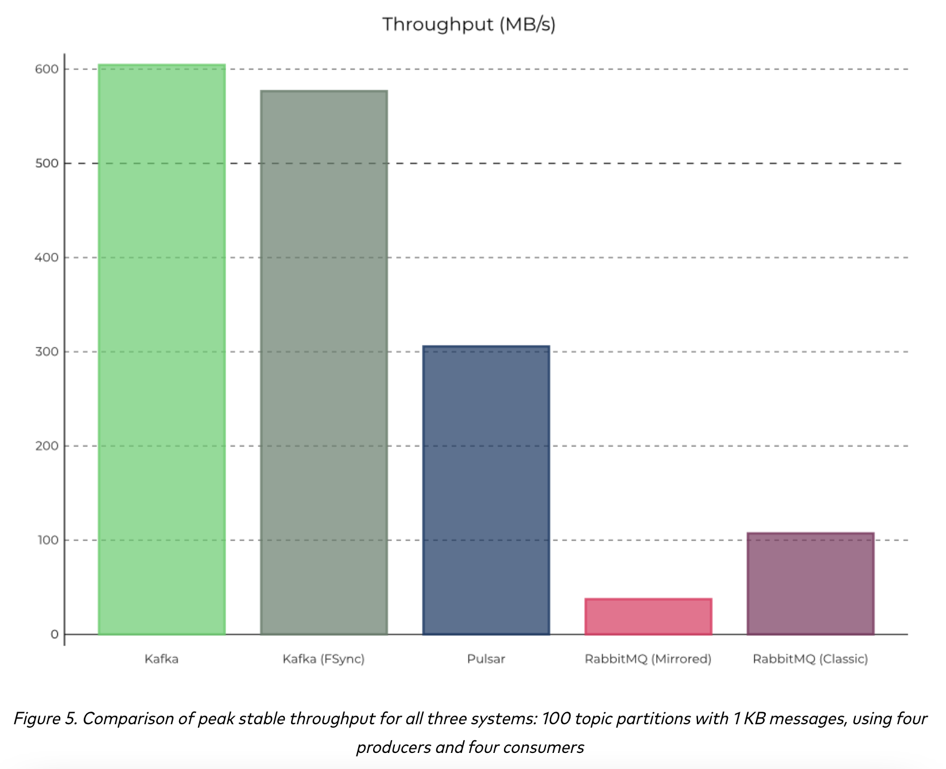
Performance
Source: https://www.confluent.io/blog/kafka-fastest-messaging-system/

Slide 110
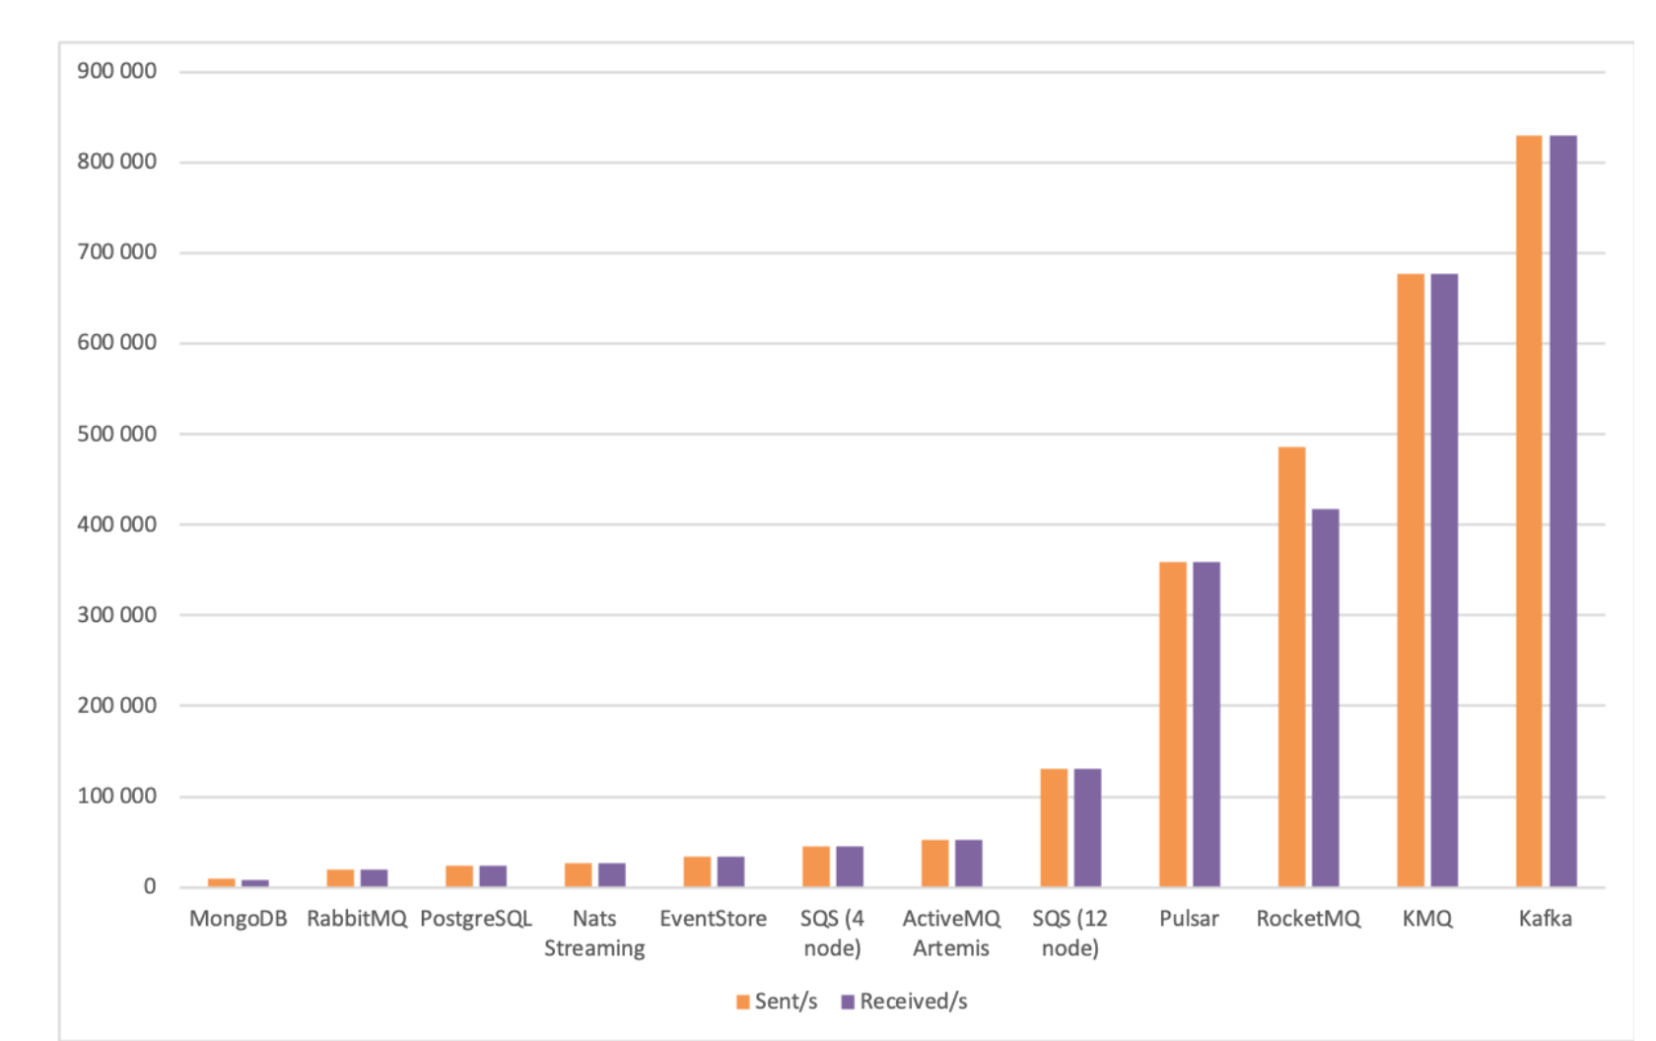
Performance
Source: https://softwaremill.com/mqperf/

Slide 111
Performance
Kafka has almost always best throughput
Latency is not always that good
Scales great
Wins most of the benchmarks

Slide 112
The Producer

Slide 113
The Producer
The producer is responsible for sending data into the cluster
There different types of API – will cover that later on
Let’s analyse 2 important design decisions:
Load balancing
Asynchronous send

Slide 114
Load Balancing
The producer sends data directly to the broker that is the leader for the partition without any intervening routing tier.
To help the producer do this all Kafka nodes can answer a request for metadata about which servers are alive and where the leaders for the partitions of a topic are at any given time to allow the producer to appropriately direct its requests.
The client controls which partition it publishes messages to.
This can be done at random, implementing a kind of random load balancing, or it can be done by some semantic partitioning function.

Slide 115
Asynchronous send
Batching is one of the big drivers of efficiency
batching the Kafka producer will attempt to accumulate data in memory and to send out larger batches in a single request.
The batching can be configured to accumulate no more than a fixed number of messages and to wait no longer than some fixed latency bound (say 64k or 10 ms).
This buffering is configurable and gives a mechanism to trade off a small amount of additional latency for better throughput.

Slide 116
Exercise 3

Slide 117
The Consumer

Slide 118
The Consumer
The Kafka consumer works by issuing "fetch" requests to the brokers leading the partitions it wants to consume.
The consumer specifies its offset in the log with each request and receives back a chunk of log beginning from that position.
The consumer thus has significant control over this position and can rewind it to re-consume data if need be.

Slide 119
Pull vs Push
Kafka at the beginning considered whther consumers should pull data from brokers or brokers should push data to the consumer
Final design:
data is pushed to the broker from the producer
Data is pulled from the broker by the consume

Slide 120
The Consumer - pull
Push - consumer needs to always handle all the load
A pull-based system has the nicer property that the consumer simply falls behind and catches up when it can.
pull-based allows batching of data sent to the consumer
Pull-based are better for slower consumer
Pull-based allows to have more consumer with vary performance

Slide 121
The Consumer – Consumer position
Keeps track of what has been consumed
Most messaging systems keep metadata about what messages have been consumed on the broker.
If the broker records a message as consumed immediately every time it is handed out over the network
then if the consumer fails to process the message that message will be lost.
To solve this problem, many messaging systems add an acknowledgement feature

Slide 122
The Consumer – Acknowledgement
This strategy fixes the problem of losing messages, but creates new problems.
if the consumer processes the message but fails before it can send an acknowledgement then the message will be consumed twice
The second problem is around performance, now the broker must keep multiple states about every single message

Slide 123
The Consumer – Consumer position
Kafka handles this differently.
Topic is divided into a set of totally ordered partitions, each of which is consumed by exactly one consumer within each subscribing consumer group at any given time.
This means that the position of a consumer in each partition is just a single integer, the offset of the next message to consume.

Slide 124
Source: https://kafka.apache.org/intro

Slide 125
The Consumer – Consumer position
There is a side benefit of this decision.
A consumer can deliberately rewind back to an old offset and re-consume data.
This violates the common contract of a queue
But turns out to be an essential feature for many consumers

Slide 126
Exercise 4

Slide 127
The Consumer – Static membership
Static membership aims to improve the availability of stream applications, consumer groups and other applications built on top of the group rebalance protocol. The rebalance protocol relies on the group coordinator to allocate entity ids to group members. These generated ids are ephemeral and will change when members restart and rejoin. For consumer based apps, this "dynamic membership" can cause a large percentage of tasks re-assigned to different instances during administrative operations such as code deploys, configuration updates and periodic restarts.

Slide 128
Message Delivery Semantics

Slide 129
Message Delivery Semantics
There are multiple possible message delivery guarantees that could be provided:
At most once —Messages may be lost but are never redelivered.
At least once—Messages are never lost but may be redelivered.
Exactly once—this is what people actually want, each message is delivered once and only once.
It's worth noting that this breaks down into two problems: the durability guarantees for publishing a message and the guarantees when consuming a message.

Slide 130
Message Delivery Semantics
Many systems claim to provide "exactly once" delivery semantics,
but it is important to read the fine print,
most of these claims are misleading (i.e. they don't translate to the case where consumers or producers can fail, cases where there are multiple consumer processes, or cases where data written to disk can be lost).

Slide 131
Message Delivery Semantics - Producer
Kafka's semantics are straight-forward. When publishing a message we have a notion of the message being "committed" to the log.
Once a published message is committed it will not be lost as long as one broker that replicates the partition to which this message was written remains "alive".

Slide 132
Message Delivery Semantics - Producer
Kafka's semantics are straight-forward. When publishing a message we have a notion of the message being "committed" to the log.
Once a published message is committed it will not be lost as long as one broker that replicates the partition to which this message was written remains "alive".

Slide 133
Message Delivery Semantics - Producer
Case:
if a producer failed to receive a response indicating that a message was committed, it had little choice but to resend the message
Kafka producer is idempotent this guarantees that resending will not result in duplicate entries in the log
To achieve this, the broker assigns each producer an ID and deduplicates messages using a sequence number that is sent by the producer along with every message.

Slide 134
Message Delivery Semantics - Producer
Case:
Producer sends data to two different topics
The producer supports the ability to send messages to multiple topic partitions using transaction-like semantics
either all messages are successfully written or none of them are.
The main use case for this is exactly-once processing between Kafka topics.

Slide 135
Message Delivery Semantics - Producer
Not all use cases require such strong guarantees.
For uses which are latency sensitive we allow the producer to specify the durability level it desires.
If the producer specifies that it wants to wait on the message being committed this can take on the order of 10 ms.
However the producer can also specify that it wants to perform the send completely asynchronously
or that it wants to wait only until the leader (but not necessarily the followers) have the message.

Slide 136
Exercise 5

Slide 137
Message Delivery Semantics - Consumer
All replicas have the exact same log with the same offsets.
The consumer controls its position in this log
If the consumer never crashed it could just store this position in memory
If the consumer fails we need to choose position from which to start processing
We have several options for processing the messages and updating its position.

Slide 138
Consumer - at-most-once
It can read the messages, then save its position in the log, and finally process the messages.
the consumer may crash after saving its position but before saving the output of its message
In this case the process that took over processing would start at the saved position even though a few messages prior to that position had not been processed.
This corresponds to "at-most-once" semantics as in the case of a consumer failure messages may not be processed.

Slide 139
Consumer – at-least-once
It can read the messages, process the messages, and finally save its position.
In this case there is a possibility that the consumer process crashes after processing messages but before saving its position.
In this case when the new process takes over the first few messages it receives will already have been processed.
This corresponds to the "at-least-once" semantics in the case of consumer failure.
In many cases messages have a primary key and so the updates are idempotent (receiving the same message twice just overwrites a record with another copy of itself).

Slide 140
Consumer - Exactly once
When consuming from a Kafka topic and producing to another topic (as in a Kafka Streams application), we can leverage the new transactional producer capabilities
The consumer's position is stored as a message in a topic, so we can write the offset to Kafka in the same transaction as the output topics receiving the processed data
If the transaction is aborted, the consumer's position will revert to its old value and the produced data on the output topics will not be visible to other consumers, depending on their "isolation level."

Slide 141
Consumer - Exactly once
When writing to an external system, the limitation is in the need to coordinate the consumer's position with what is actually stored as output.
The classic way of achieving this would be to introduce a two-phase commit between the storage of the consumer position and the storage of the consumers output.

Slide 142
Consumer – Isolation level
read_committed - ensures that we don't read any transactional messages before the transaction completes.
read_uncommitted – default value prior to Kafka 3.0 – allows to read records from topic even if they are not commited

Slide 143
Exercise 6

Slide 144
Replication

Slide 145
Replication
Kafka replicates the log for each topic's partitions across a configurable number of servers
You can set this replication factor on a topic-by-topic basis
This allows automatic failover to these replicas when a server in the cluster fails
The fundamental guarantee a log replication algorithm must provide is that if we tell the client a message is committed, and the leader fails, the new leader we elect must also have that message.

Slide 146
Replicas
Replica is a backup of a partition
Replication factor tells the cluster how many of identical replicas should be created on the cluster
Replicas are never used to read or write data.
They are used to prevent data loss.
There can be one or many replicas of a partition
One leader and many followers
In-Sync Replica is a replica that has enough records to be considered in partition leader election

Slide 147
Quorum
When the leader does die we need to choose a new leader from among the followers
Quorum algorithm is used to get new leader
Kafka dynamically maintains a set of in-sync replicas (ISR) that are caught-up to the leader. Only members of this set are eligible for election as leader.
There are multiple algorithms to choose new leader – Kafka is closest to PacificA from Microsoft.

Slide 148
Acknowledgment in Kafka
Types of Acknowledgment
ACK=0 [NONE]
ACK=1 [LEADER]
ACK= -1 [ALL]

Slide 149
In Sync Replica
Configuration min.insync.replica is the minimum number of replicas that must acknowledge that data was received successfully for a write to be successful.
Replica is in sync when replica has been fully caught up with the leader in the last 10 seconds.
The setting for this time period is: replica.lag.time.max.ms and has a server default which can be overridden on a per topic basis.

Slide 150
Exercise 7

Slide 151
Log compaction

Slide 152
Log Compaction
Retains at least the last known value for each record key for a single topic partition
Compacted logs are useful for restoring state after a crash or system failure.
Used also for deletion of single message

Slide 153
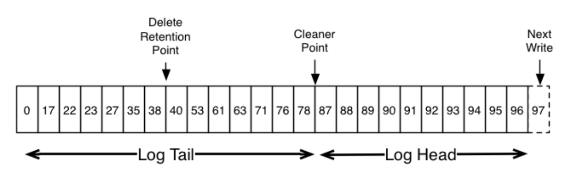
Log Compaction
Source: https://kafka.apache.org/intro

Slide 154
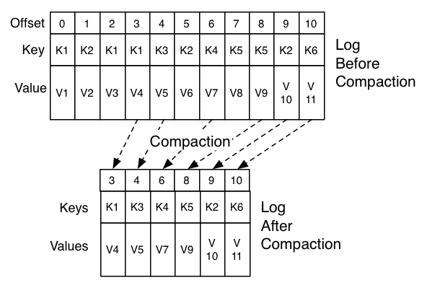
Log Compaction
Source: https://kafka.apache.org/intro

Slide 155
Log Compaction
Log compaction guarantees the following:
Any consumer that stays caught-up to within the head of the log will see every message that is written; config min.compaction.lag.ms can be used to guarantee the minimum length of time must pass after a message is written before it could be compacted
Ordering of messages is always maintained. Compaction will never re-order messages, just remove some.
The offset for a message never changes. It is the permanent identifier for a position in the log.

Slide 156
Log Compaction - configuration
log.cleanup.policy=compact
is a broker configuration setting defined in the broker's server.properties file
log.cleaner.min.compaction.lag.ms
used to prevent messages newer than a minimum message age from being subject to compaction

Slide 157
Exercise 8

Slide 158
Quotas

Slide 159
Multi Tenancy
You can deploy Kafka as a multi-tenant solution.
Multi-tenancy is enabled by configuring which topics can produce or consume data
Support for quotas - administrators can define quotas to control the broker resources that are used by clients.

Slide 160
Quotas
Quota configuration may be defined for (user, client-id), user and client-id groups.
Network Bandwidth Quotas
Network bandwidth quotas are defined as the byte rate threshold for each group of clients sharing a quota
Request Rate Quotas
Request rate quotas are defined as the percentage of time a client can utilize on request handler I/O threads and network threads of each broker within a quota window.

Slide 161

Kafka API

Slide 162
Kafka API
Producer API
Consumer API
Kafka Connect
Kafka Streams
Admin API

Slide 163
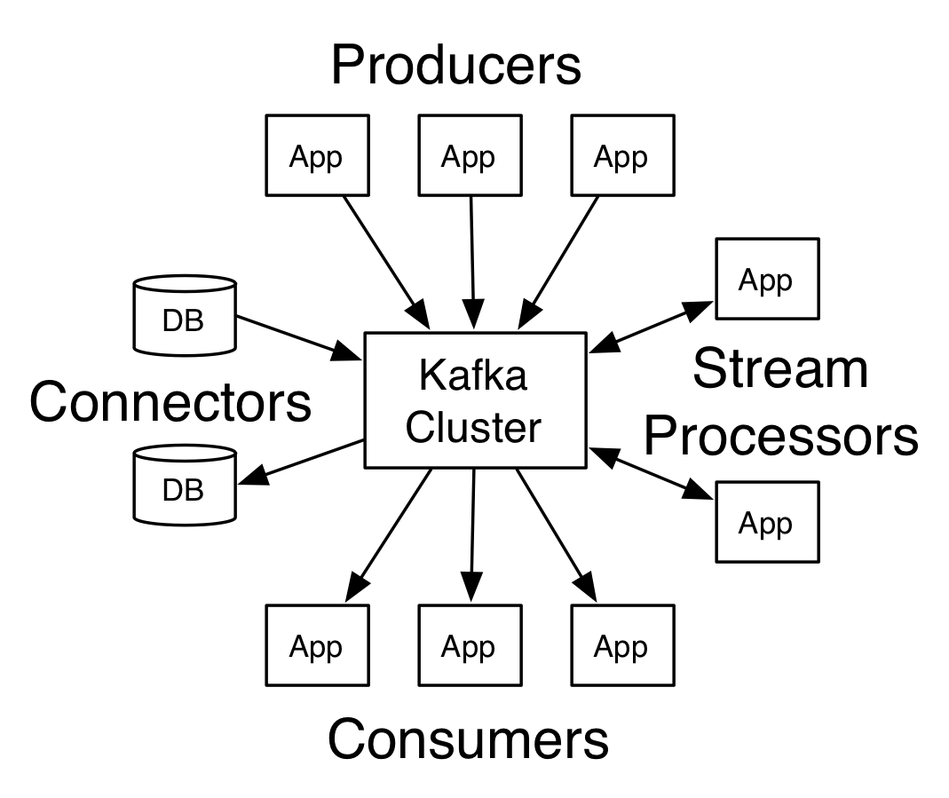
Kafka API
Source: https://kafka.apache.org/intro

Slide 164
Producer API
The Producer API allows an application to publish a stream of records to one or more Kafka topics.
Already covered.

Slide 165
Consumer API
The Consumer API allows an application to subscribe to one or more topics and process the stream of records produced to them.
Already covered.

Slide 166
Streams API
The Streams API allows an application to act as a stream processor, consuming an input stream from one or more topics and producing an output stream to one or more output topics, effectively transforming the input streams to output streams.

Slide 167
Streams API
Kafka Streams is a client library for building applications and microservices,
input and output data are stored in Kafka clusters.
Application is run outside of the cluster
Supports exactly-once processing semantics
Offers necessary stream processing primitives, along with a high-level Streams DSL and a low-level Processor API.
Supports fault-tolerant local state

Slide 168
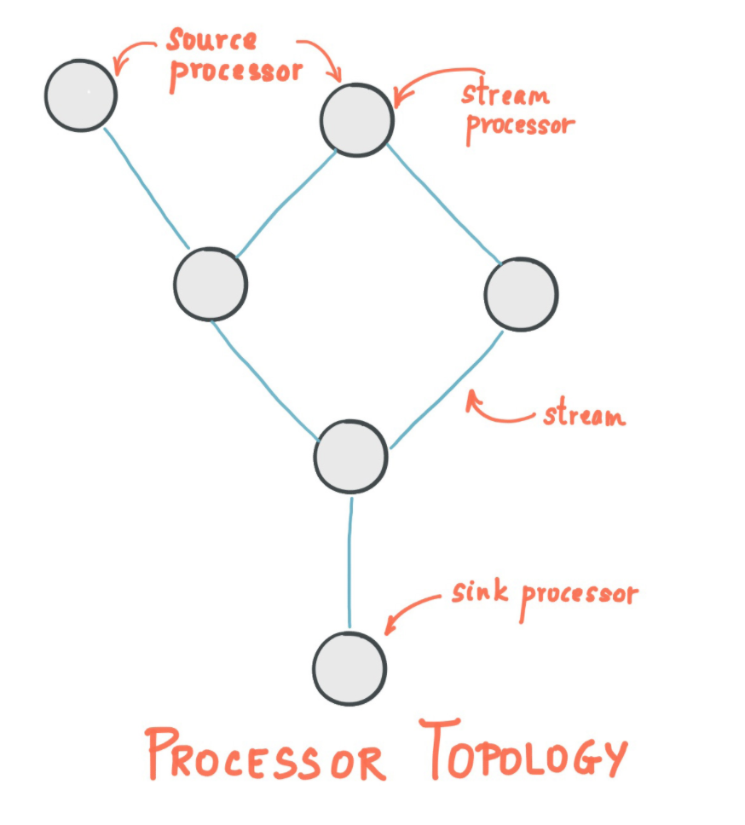
Streams API

Slide 169
Streams API
A stream is the most important abstraction provided by Kafka Streams: it represents an unbounded, continuously updating data set.
A stream processing application is any program that makes use of the Kafka Streams library
A stream processor is a node in the processor topology; it represents a processing step to transform data in streams by receiving one input record at a time from its upstream processors in the topology

Slide 170
Streams API
There are two special processors in the topology:
Source Processor: A source processor is a special type of stream processor that does not have any upstream processors. It produces an input stream to its topology from one or multiple Kafka topics by consuming records from these topics and forwarding them to its down-stream processors.
Sink Processor: A sink processor is a special type of stream processor that does not have down-stream processors. It sends any received records from its up-stream processors to a specified Kafka topic.

Slide 171
Kafka Streams DSL
Kafka Streams offers two ways to define the stream processing topology:
Kafka Streams DSL provides the most common data transformation operations such as map, filter, join and aggregations out of the box;
Lower-level Processor API allows developers define and connect custom processors as well as to interact with state stores.

Slide 172
Exercise 9

Slide 173
Connector API
The Connector API allows building and running reusable producers or consumers that connect Kafka topics to existing applications or data systems. For example, a connector to a relational database might capture every change to a table.

Slide 174
Connector API
Kafka Connect is a framework for connecting Kafka with external systems such as databases, key-value stores, search indexes, and file systems, using so-called Connectors.
Kafka Connectors are ready-to-use components, which can help us to import data from external systems into Kafka topics and export data from Kafka topics into external systems. We can use existing connector implementations for common data sources and sinks or implement our own connectors.

Slide 175
Kafka Connect
A common framework for Kafka connectors - Kafka Connect standardizes integration of other data systems with Kafka, simplifying connector development, deployment, and management
Distributed and standalone modes - scale up to a large, centrally managed service supporting an entire organization or scale down to development, testing, and small production deployments
REST interface - submit and manage connectors to your Kafka Connect cluster via an easy to use REST API

Slide 176
Kafka Connect
Automatic offset management - with just a little information from connectors, Kafka Connect can manage the offset commit process automatically so connector developers do not need to worry about this error prone part of connector development
Distributed and scalable by default - Kafka Connect builds on the existing group management protocol. More workers can be added to scale up a Kafka Connect cluster.
Streaming/batch integration - leveraging Kafka's existing capabilities, Kafka Connect is an ideal solution for bridging streaming and batch data systems

Slide 177
Connectors Library
https://www.confluent.io/hub/

Slide 178
Exercise 10

Slide 179

Thanks!

